Slide 1
From pixels to patients
GUEST LECTURE · MEDICAL INFORMATICS · AI & COMPUTER VISION
AI in medical imaging, a zoom into orthopaedics, and what it takes to get a model into the clinic
Dennis Alexander Krap · Co-founder & CEO, AtMoves (Amsterdam UMC spin-off)
UvA Amsterdam· Oct 8, 2026

Slide 2
“And If the algorithm has 94% accuracy, why isn't every hospital using it?”
DICE = 0.94
So what?

Slide 3
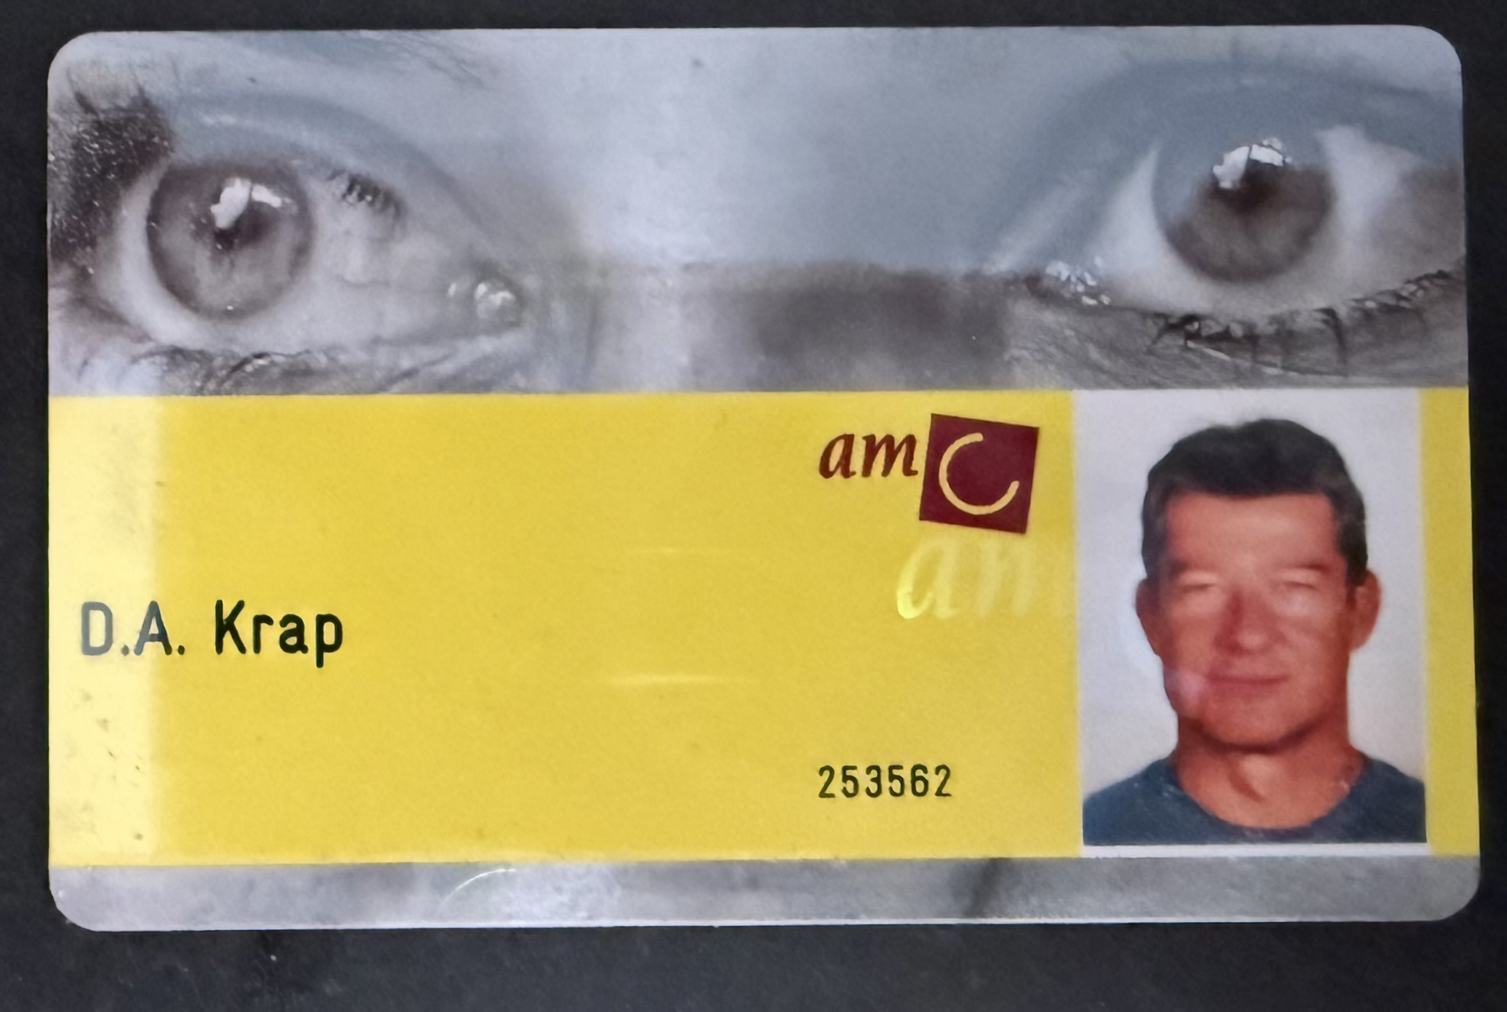
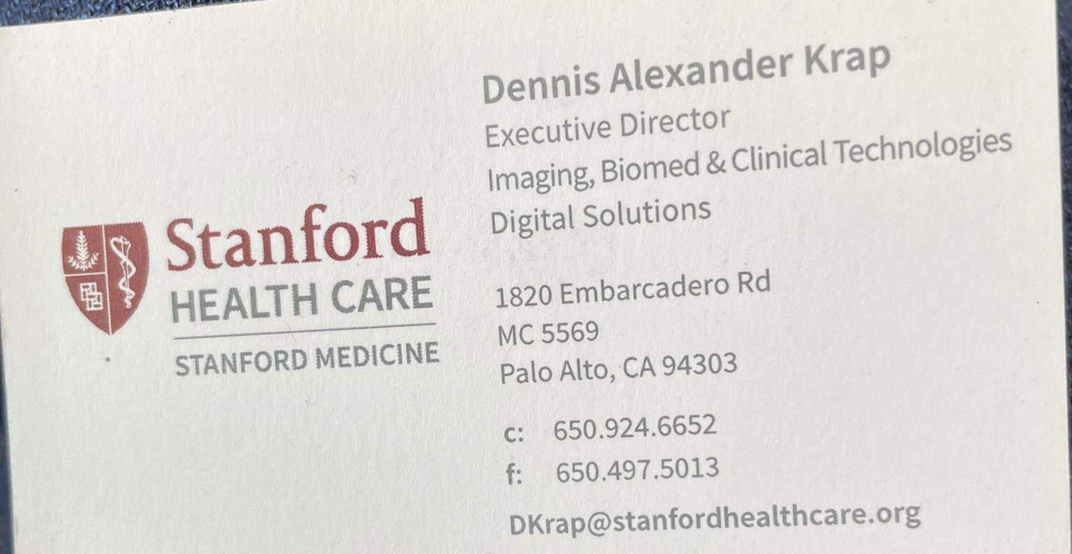
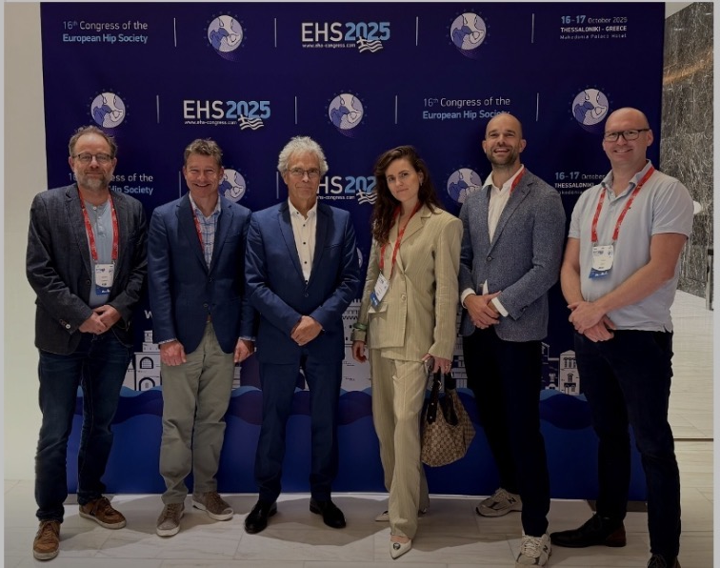
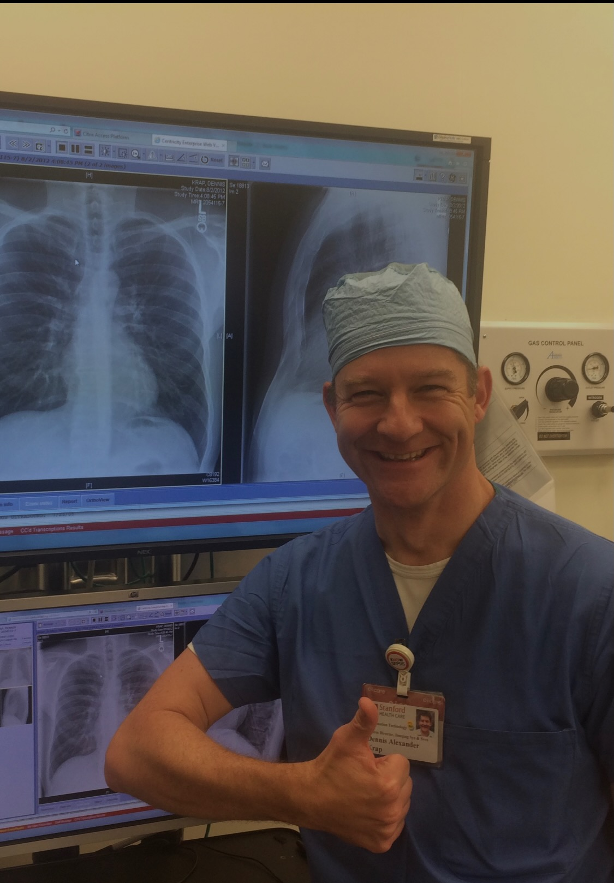
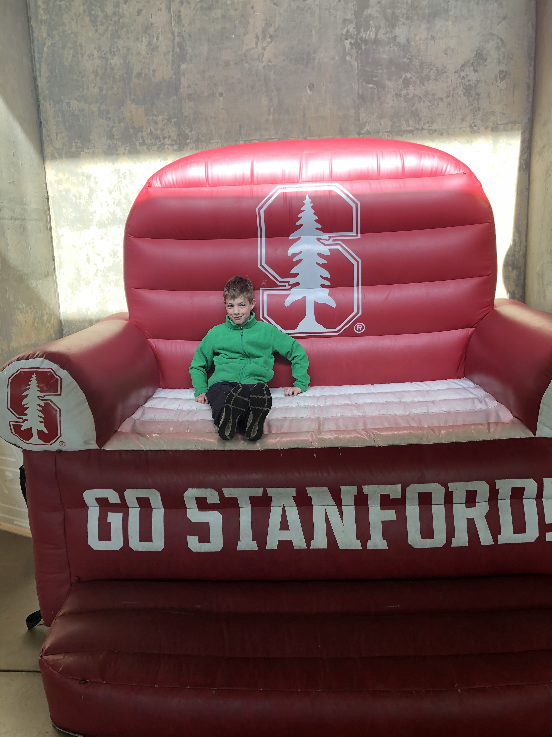
California SF Bay area- highly recommended-
Notes:
Long tenure with Philips
new product introduction for time of flight PET-CT and PET-MR. Milpitas CA & Cleveland OH
M&A integrtaion Stentor PACS as a Software Service model –wavelet based losless compresion combined with a pay per exam business model Silently build up 12 Petabyte medical images now driving Philips AI development (ao Healthsuite)
Then Stanford all clinical technologies except for core EHR (patient charting-schedules-claims and billing) BIG change from industry- very highly specialized-many sub specialized thousands of devices and even more applications. No shortage of money and talent.
Now UMC-Amsterdam spin-off, always short on money, leaner (not more efficient though) very highly regarded science and care. > No pain no gain but lots of fun.

Slide 4
Not much hardcore ML today
20 min
10 min
25 min
10 min
Story telling
Orthopaedics zoom
Research → clinic → company
Q&A
And a link to current relevant AI in medical imaging in 2026
Bring the hard questions
The field, and one case from lab to product
Regulation, evidence, workflow, who pays, building a spin-off, lessons learned

Slide 5
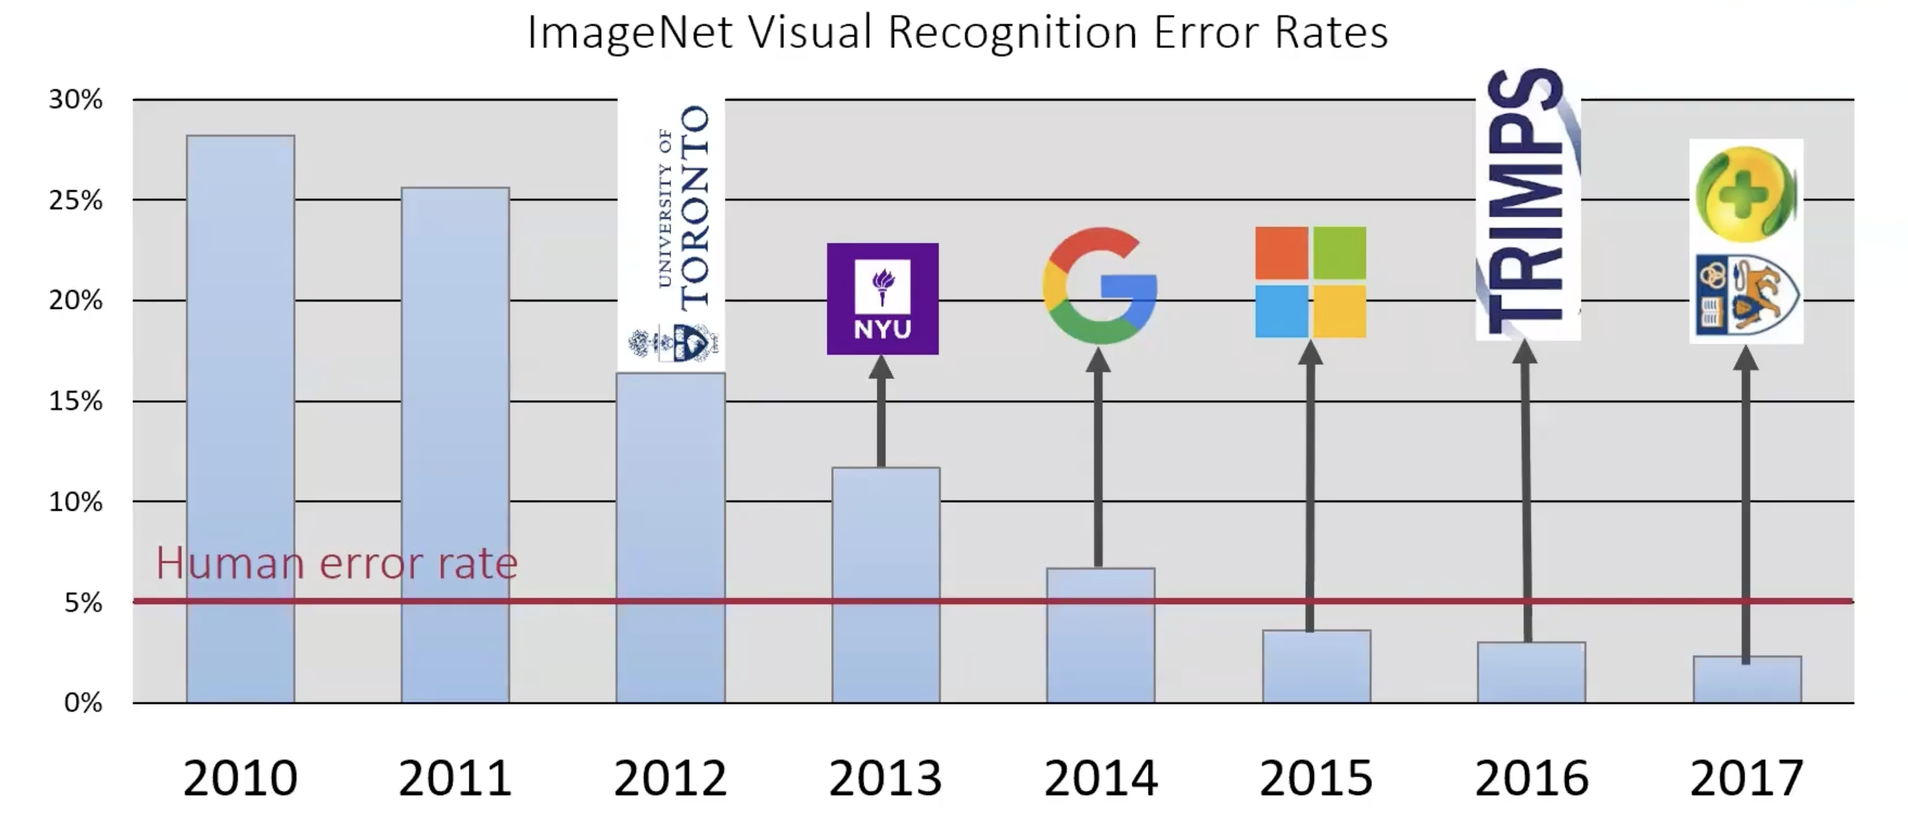
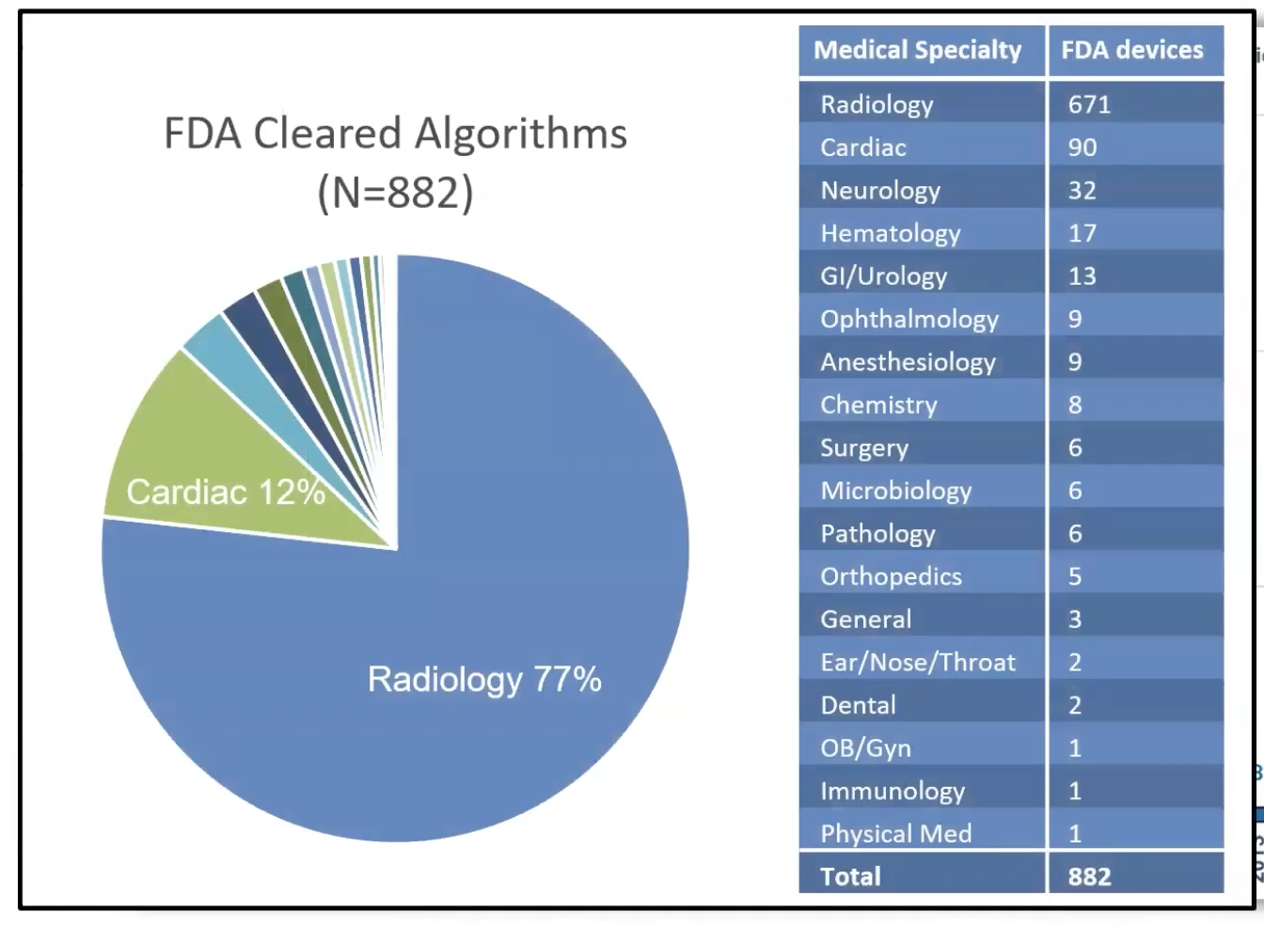
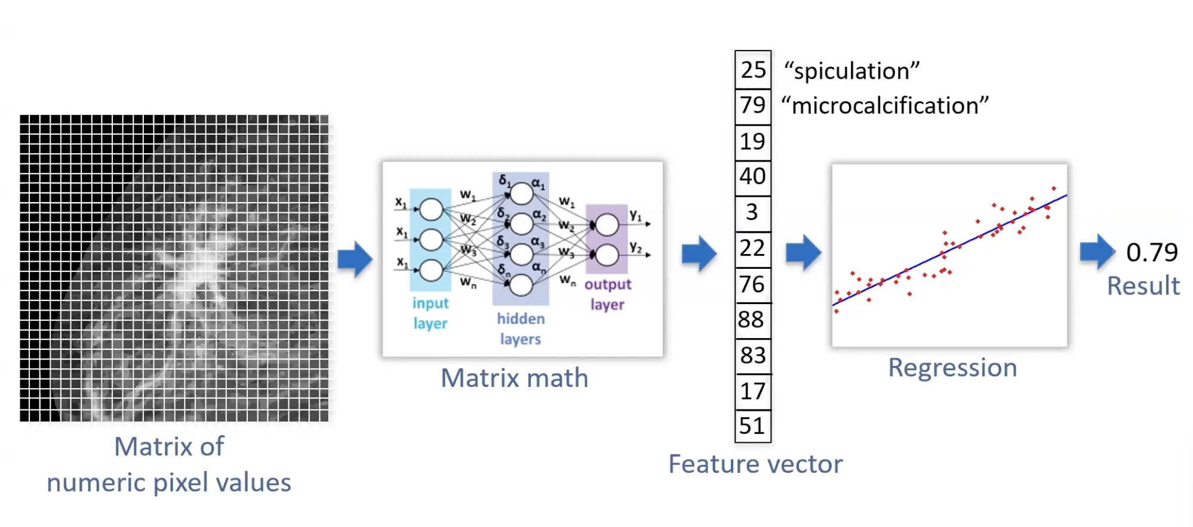
From origins of ML to today practice
Notes:
From the early imageNet to first NN and back propogation the imaging AI space exploded.

Slide 6
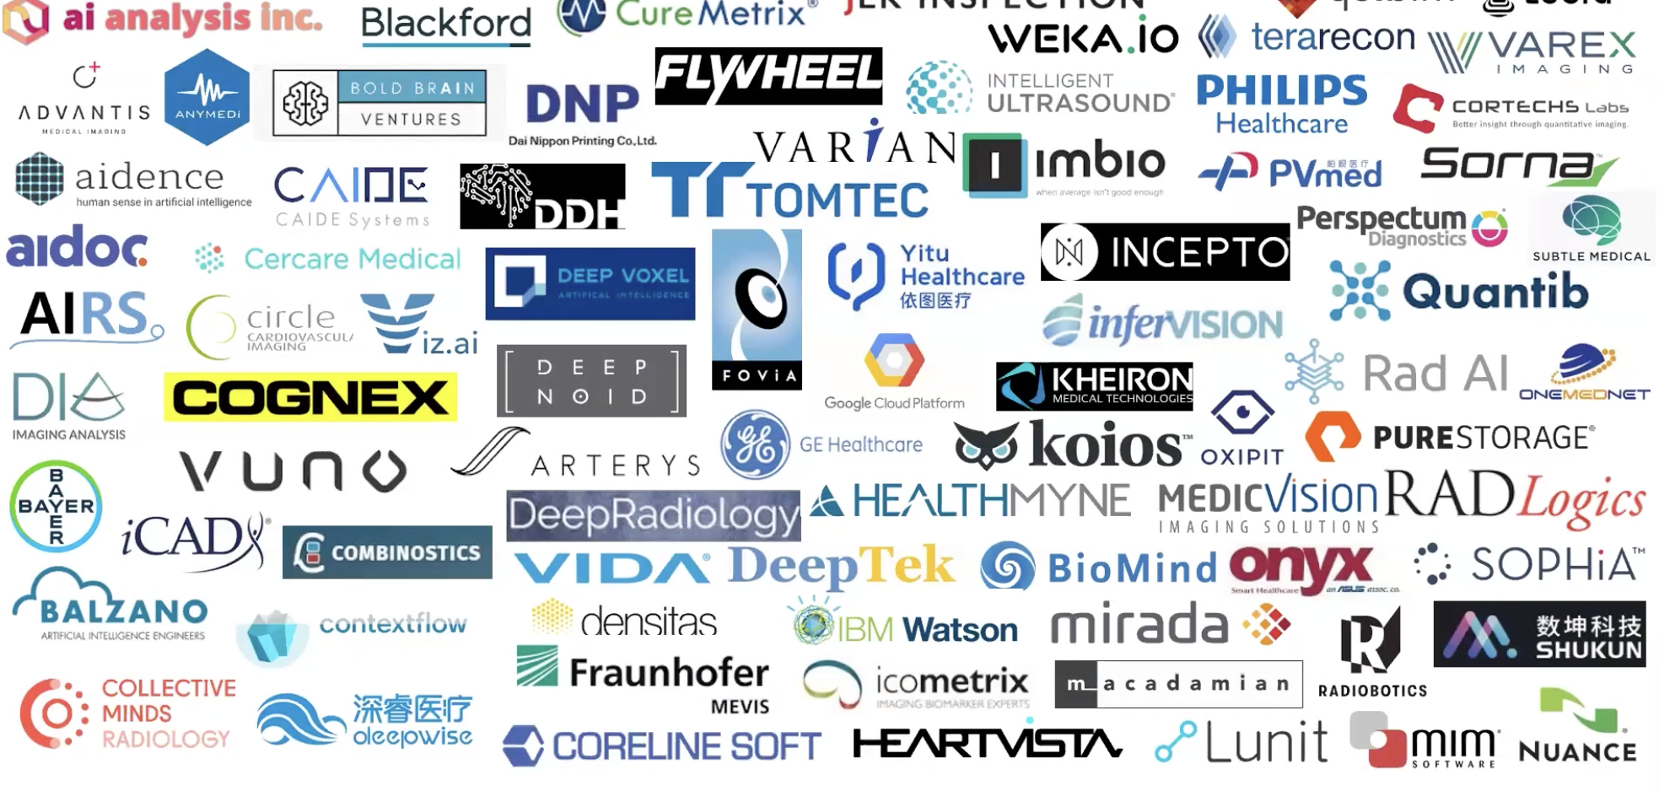
From origins of ML to today practice
> machine learning is well suited to create useful imaging applications
Notes:
2021 RSNA (2025 did not fit on one page anymore)

Slide 7
Imaging is where medical AI reaches the market first. Most products are incremental, not new categories.
STATE OF THE ART · 2026 you are the right time, at the right place
76%
1,614
are radiology
96%
AI-enabled devices on the FDA list
cleared via 510(k), against a predicate
Source: FDA AI-enabled device list, update of 4 Sept 2026 (decisions to 29 June 2026), via Complizen tracker
Notes:
Radiology dominates because the input is already digital and standardised (DICOM). The 96% via 510(k) matters,: almost every product proves it is similar to something already cleared. what does that mean for a truly new idea? It means a harder, slower route to market access (De Novo).

Slide 8
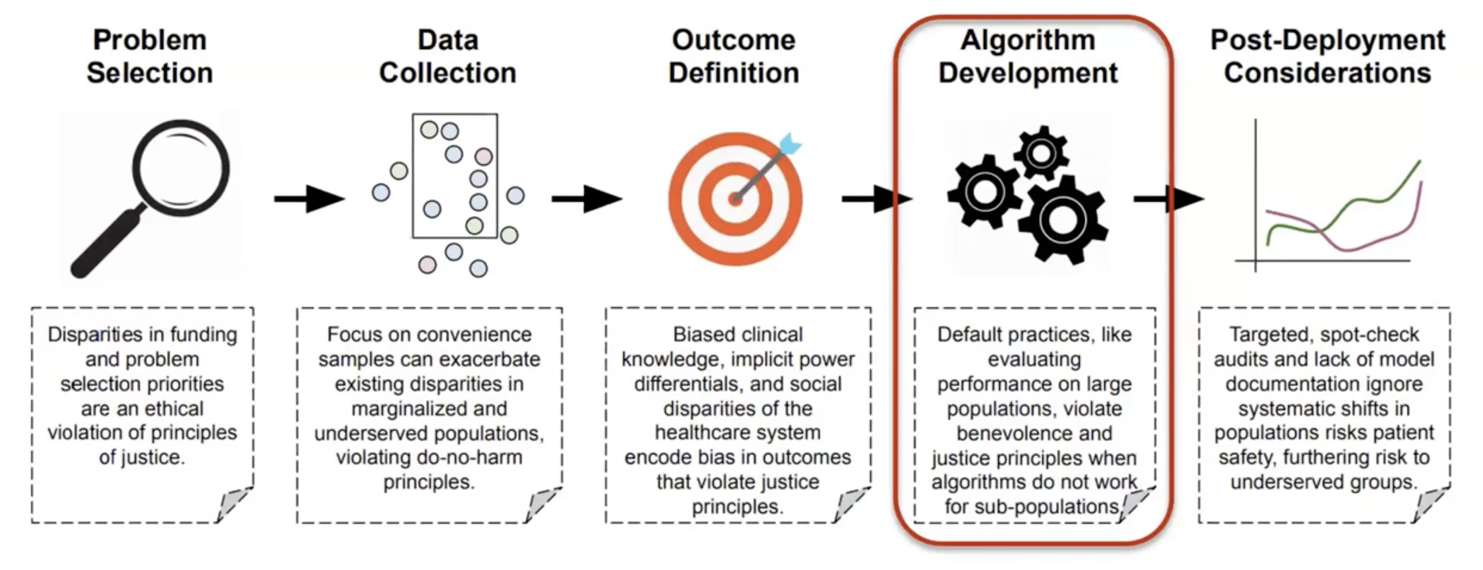
Bias – from origin of ML to today practice
Eg fine tuning vision language> increasingly more aware of challenges and get better at optimizing
Availability of useful data is still a challenge
Very hot research area and high market interest !
Courtesy AIMI lab Stanford California, USA
Notes:
With what we know today about shortfall of AI models would the models approved by FDA or MDR CE been approved?
Many data-sets on basis of which the model showed high performancehad significant bias problem (either in size or gender-race-age etc)
See https://www.cortechs.ai/wp-content/uploads/2018/10/Normative-Database-White-Paper.pdf

Slide 9
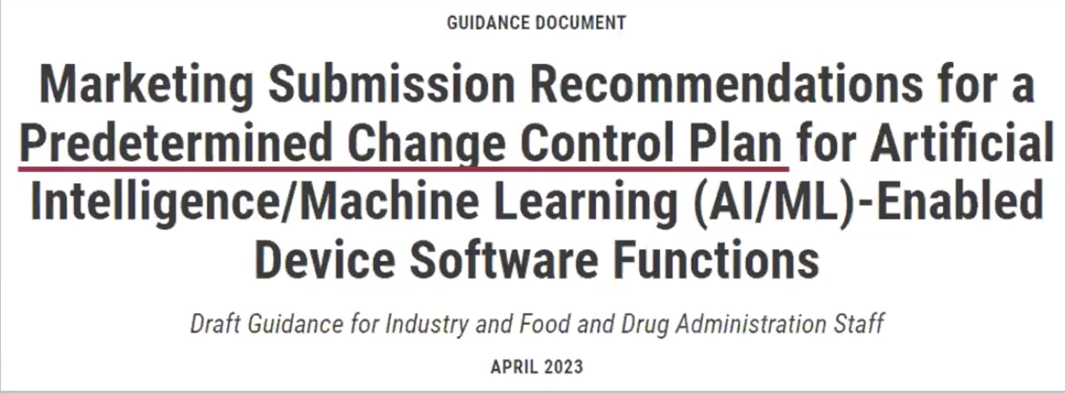
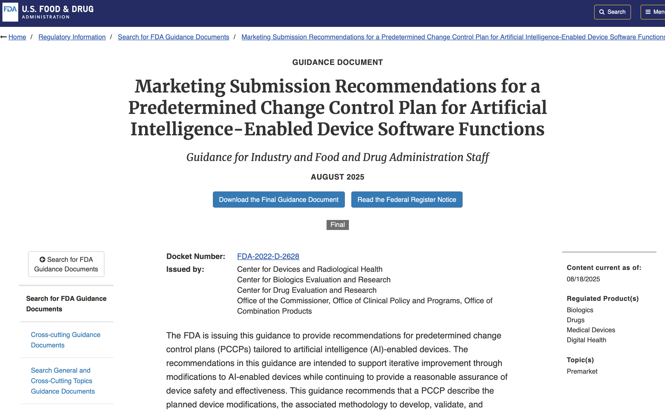
From origins of ML to today practice
Where dit Watson Health go?
Notes:
"Watson cures cancer" was promised before there was clinical validation. (btw they spend 1.2 B USD to buy radiology data)
The wrong data. It used synthetic and single-centre cases, so it didn't generalise to other hospitals (espesc in APAC-dataset bias)
There was no payer (insurance-reimbursement) to pay for it.
Trust gone and hospitals did not have a good businesscase
Ceased business…
With the knowledge today those AI model would have never been approved see FDA updated ruling.

Slide 10
From origins of ML to today practice
Foundation models
Vision-language models
One pretrained model, many tasks: segmentation, classification and retrieval across CT, MRI and X-ray.
Images in, draft reports out. Triage and report drafting are the first realistic uses.
Segmentation is a commodity
Regulation catches up
nnU-Net-style pipelines make 3D segmentation routine. The value moves to what you measure with it.
EU AI Act: AI in medical devices must meet high-risk requirements from 2 August 2028, on top of the MDR.
Notes:
model capability is no longer the bottleneck. Segmentation that was a PhD five years ago is now a library call. What you build on top, and how you prove it, is where the value is.

Slide 11
The reality check: a benchmark is not a bedside
What papers report | What the clinic needs to know
AUC on a public benchmark | Does it hold on our scanner, our protocol, our patients?
Millions of images or patches | How many independent patients and centres?
Model versus radiologist | Radiologist with the model versus without it
Accuracy | Reporting time, decisions changed, patient outcome
One frozen model | Version control, drift monitoring, revalidation after updates
Most evidence is still retrospective. The realistic first jobs for large models are limited and reviewable: triage, report drafts, risk scores.
Based on: review of medical imaging foundation models and clinical translation, Med J Peking Union Med Coll Hosp, July 2026
Notes:
Every row on the right is a question a hospital, a notified body or an insurer will ask you. If your thesis answers the left column, you are halfway. Patient-level independence: leakage between train and test at patch level is the most common silent error in thesis’

Slide 12
Progress but a long way to go
ZOOM IN · ORTHOPAEDICS
~90%
≤93%
97–99%
2025
Fracture detection
Osteoarthritis grading
Implant identification
Robotics
sensitivity, ~92% specificity
accuracy, better agreement
model type from an X-ray
first autonomous knee replacement in a patient
<weak outcome evidence>
Outcome prediction scores look high (AUC up to 0.98), but almost none are externally or prospectively validated.
Sources: J Clin Med 2026;15:1751 (review) · Monogram/Zimmer Biomet, July 2025
Notes:
.Orthopaedics is a good teaching case: big volumes (about 4 million knee and hip replacements a year worldwide), clear decisions, and a huge installed base of implants that will need follow-up. Robotics gets the headlines; the quieter opportunity is diagnosis after surgery,

Slide 13
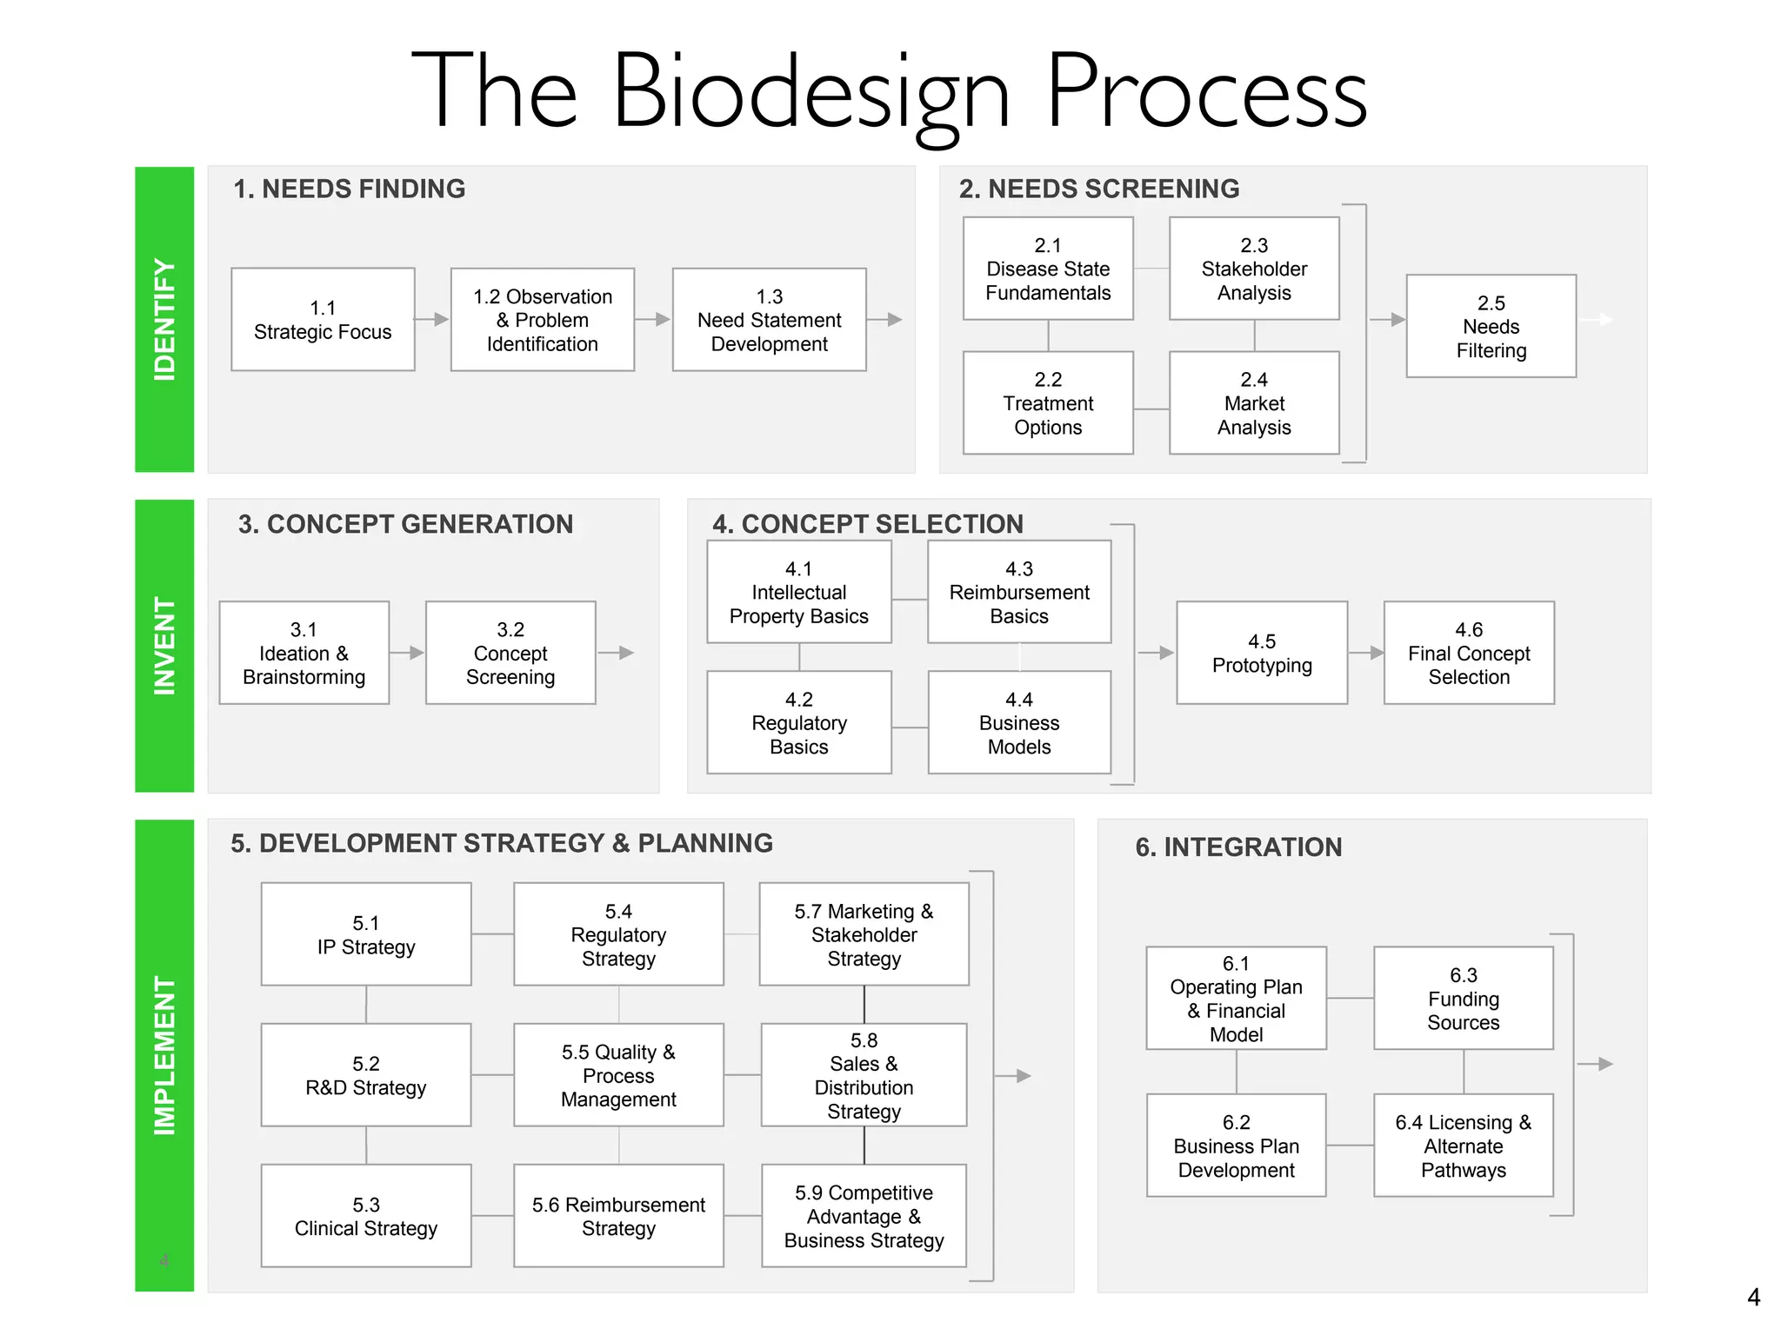
Determine the need and attractiveness
Bones are geometric.
Implants are engineered objects.
Anatomy is measurable.
Surgery is a planning problem.
A large and growing problem
High treshold to copy to enter the space (moat)
Controllable risk (no knife, needle > regulatory)
Little impact to workflow or IT infrastructure
Easy to understand who benefits – no new reimbursement code
Courtesy Stanford Biodesign, California, USA
Notes:
A method to the madness. Pick one. I use byers-design process but there are many and plenty and free formats (ask mr Google

Slide 14
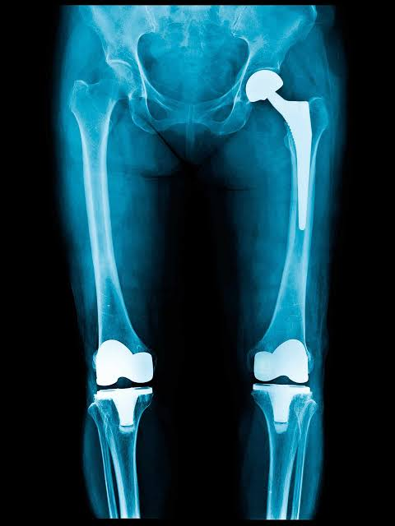
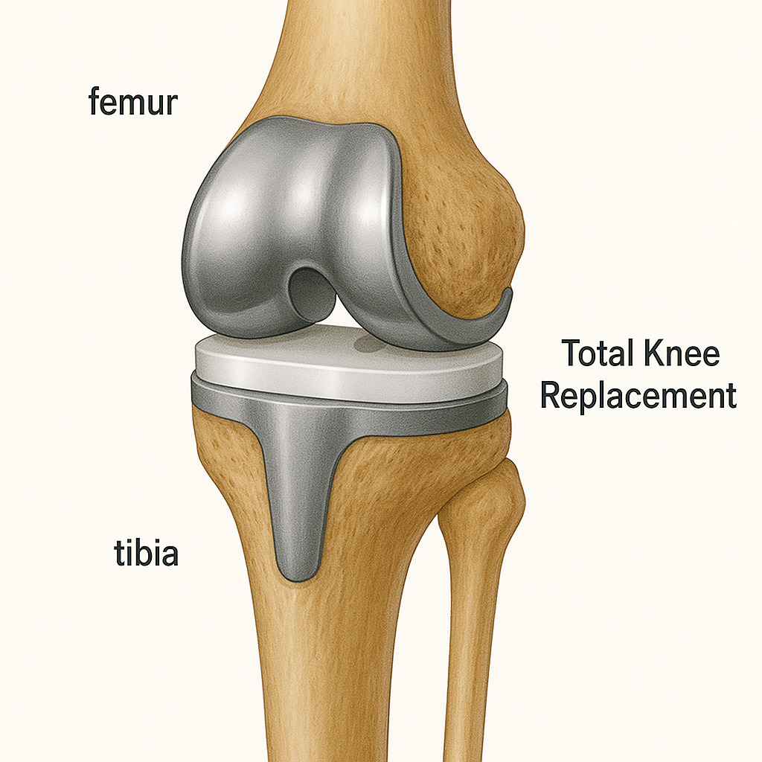
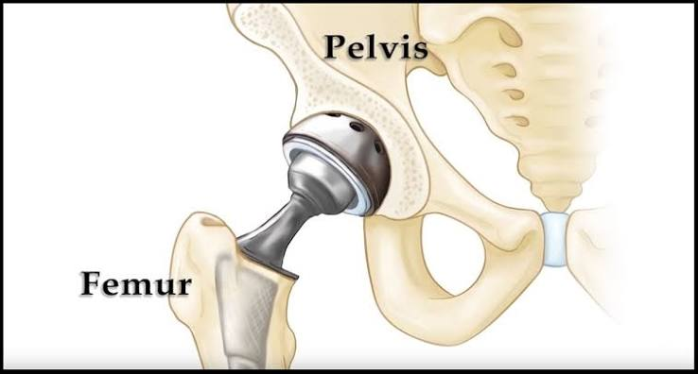
Total Joint Arthoplasty
Total hip replacement
Notes:
Very succesful primary surgery however is still is a major surgery. 20-25% dissatisfied after their initial surgery. Two major reasons 1) infection 2) aseptic loosening. Infection is to detect/ rule out. Aseptic loosening is hard. This is where the need came from.

Slide 15
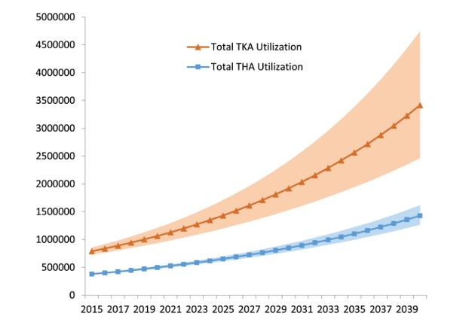
The care curb challenge
4M
15–18 yrs
knee and hip replacements worldwide — every year
typical implant lifespan: every patient eventually returns to the clinic
#1
10–15%
loosening is the leading reason for revision surgery
of revision surgeries today are unnecessary
Months
8M+
Projected annual knee (TKA) and hip (THA) replacements, 2015–2040
until a diagnosis — which is often still inconclusive
knee implants older than 5 years in the US alone
Notes:
Aging and chronic diseases are non lineair contributing to the growth.
Forgotten joint > patient who hade knee or hip replaced 18 years ago wil likely come back to clinic in b=next few years. Compounding the demand (7 Mln patients in the USA alone walking with implant placed >5 years ago

Slide 16
Is this knee implant fixated or loose? Today it takes months to find out, and the answer is often wrong.
CASE · THE LOOSE IMPLANT
~6 mo
7.3%
26%
to a diagnosis, via X-ray, CT and nuclear scans
of loose tibial components recognised on X-ray
of Danish knee revisions done for pain without loosening
Sources: Chalmers et al., J Arthroplasty 2017 · Arndt et al., Acta Orthop 2022 · AtMoves impact analysis
Notes:
14:00–16:00. Frame the problem as a clinician experiences it, not as a dataset. The patient is in pain, the surgeon must decide whether to operate again. Both errors are costly: operating on a fixed implant, or waiting too long on a loose one. Notice there is no labelled dataset for this decision; that shaped everything we built.

Slide 17

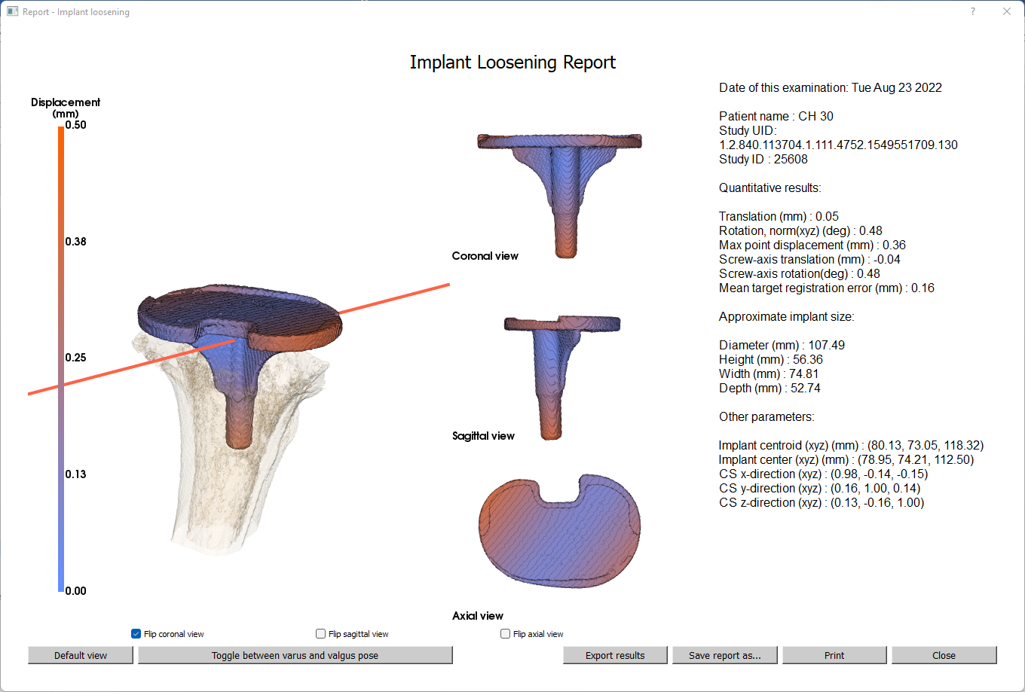
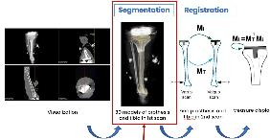
Measure movement, don't guess from a picture
1
2
3
4
CT under load
Segment
Register
Report
Standard CT, joint loaded in two directions by a small device
Deep learning separates implant and bone in 3D
Align both loaded scans and compute implant-versus-bone motion
Quantified, visual result for the surgeon in under 30 minutes
2025: the manual steps became a semi automatic nnU-Net pipeline, with excellent reliability (ICC above 0.90) and no more error than the manual method. Measured (tMag, rMag, Mtre, MTPM)
Source: Automation in tibial implant loosening detection using deep-learning segmentation, IJCARS, June 2025 (Amsterdam UMC)
Notes:
The key design choice: we did not train a classifier on images labelled loose or fixed. We measure a physical quantity, motion, so the AI is a measurement tool, not an oracle. That makes validation, explainability and regulation much easier. The AI in this product is segmentation, the least glamorous part, and that is fine.

Slide 18
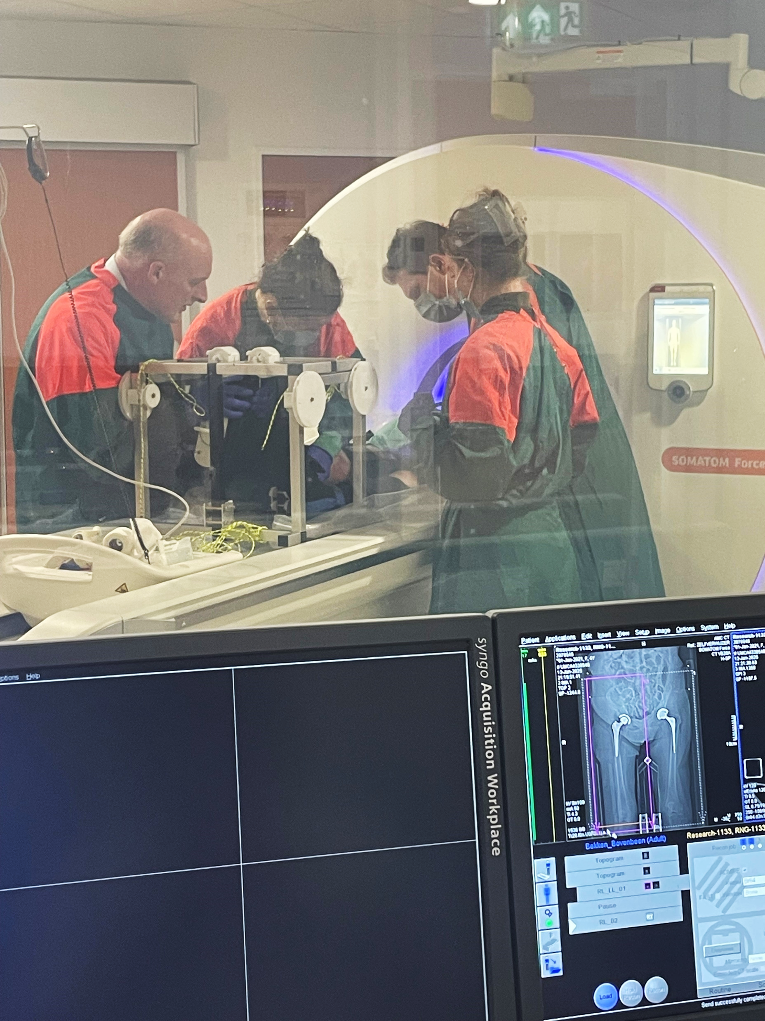
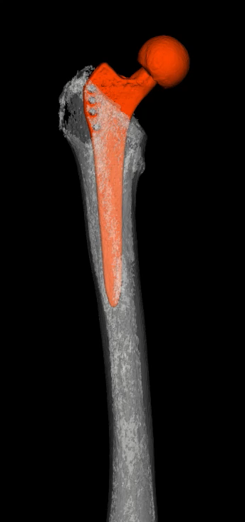
Helping the CT scan a little
Notes:
Patented loading device provides consistent moment so that confrontation CT can pick most subtle micromotion between bone and implant.

Slide 19
The model is about 10% of the product.
FROM RESEARCH TO CLINICAL ADOPTION
The other 90% is regulation, evidence, workflow, payment and people.
Notes:
The 10% is a rule of thumb from our own budget: most of the money and our time goes to software engineering around the algorithm, quality, regulatory work and getting into hospitals, not to the algorithm itself.

Slide 20
from paper to patient
2 Prototype
3 Software
6 Paid for
1 Paper
works on my data
IEC 62304, tested
4 Certified
5 Used
someone's budget
7 Changes care
AUC
CE / FDA
in the workflow
better outcomes
Notes:
Most academic work stops at step 1 or 2; that is fine, it is research. Each step up needs a different skill and a different kind of proof. steps 5 and 6 are where most good products die, not step 4.

Slide 21
Regulation: your intended use decides everything
 | EU (MDR) | US (FDA)
Typical class for imaging software | IIa; IIb if the output drives surgery (rule 11) | Class II
Route | Notified body reviews your technical file | 510(k) with a predicate, or De Novo
Quality system | ISO 13485 | QMSR (aligned with ISO 13485)
Software and risk | IEC 62304, ISO 14971, IEC 62366-1, IEC 81001-5-1 | Same standards recognised
AI on top | AI Act high-risk rules from Aug 2028 | Plan for changes to the algorithm (PCCP)
One sentence in your intended use, such as "supports the decision to operate", can move you up a class and add a year.
Notes:
the research code that produced your validation results becomes regulatory evidence. Freeze and document the algorithm version early.

Slide 22
Three kinds of evidence, three different audiences
TECHNICAL
CLINICAL
UTILITY
Does it measure correctly?
Is it right in patients?
Does it change care and cost?
Repeatability, phantom and cadaver tests, error versus ground truth.
Sensitivity and specificity against a reference standard, ideally multicentre.
Time to diagnosis, decisions changed, fewer unnecessary operations.
Convinces: engineers, notified body
Convinces: clinicians, regulators
Convinces: hospital boards, insurers
Notes:
Academic training is excellent at the first two columns and almost silent on the third. Yet the third is what a hospital buyer and an insurer ask for.

Slide 23
Adoption: Workflow beats accuracy
Four people must say yes
What they ask for
The surgeon who orders the test
The radiographer who scans
The radiologist who signs off
IT and security, who approves and connect you
No new scanner, no new protocol
DICOM in, report back in the patient record
Minutes, not days
Data processing agreement, security test etc
Rule of thumb: if your product needs a new login, a new device or a new habit, budget a year of change management.
The QurAI and Atmoves automated segmentation of 3D CT of lower extremities with metal implants is a very significant step towards adoption. Trust in the data selection, outcome definition and algorithm development is key.
Notes:
example: the CT scan belongs to radiology, the decision belongs to orthopaedics, the budget belongs to the hospital, and the savings go to the insurer. Each of those groups needs its own reason to say yes. For radiology MSK a loosening report like AtMoves doesn’t hurt their bottom line however they definitely don’t want to spend a minute extra > here is where the automated segmentation is key to support the adoption and move Radiology to a yes.

Slide 24
Layman summary current status and open invite to contribute
As previously presented by C.Magg and E.Simon
Current approach;after the varus valgus load induced scans;
threshold-based region-growing algorithm generates segmentation masks of the tibial cortex and the tibial implant in the valgus scan and tibial implant in the varus scan
User set manual seedpoint and can manual adjust the predefined treshold if needed
a polygon mesh generated by the Marching Cubes algorithm
alignment of varus valgus contour using Iterative Closest Point registration
double-contour sampled and point-to-image registration optimized by Nelder-Mead downhill algorithm
Proposed and in process;
- Replace semi-automated steps by fully automated utilizing nnU-Net model
- avoid overlap bone and implant mask, dilate with a circular structural element. Remove bone mask overlapping
Increase user trust by introducing performane score (likelyhood) of the automated segmentation model
If you are interested in AI for orthopedics and or movement science there is still lots of work to be done with a true impact at the end…

Slide 25
Who pays? The user, the buyer and the one who saves are three different parties.
USES IT
PAYS FOR IT
SAVES MOST
Surgeon and radiologist
Hospital
Insurer and society
Wants a clear answer, fast
Inside an existing reimbursement fee, the Dutch DBC
Fewer unnecessary interventions, less time off work
Sources: AtMoves impact analysis; LROI cost estimate per revision
Notes:
In the Netherlands hospital care for joint replacement is paid through DBC packages, so a new test usually has to fit inside an existing package or get a temporary innovation code from the NZa. In the US, coding (CPT) is the equivalent with a bundled pay structure. Withing the EU this can also differ significantly per country, and this effort needs to be carefully planned in the market expansion planning.

Slide 26
Eight years and € 3.5M from first grant to certified product
BUILDING A medtech class2a SPIN-OFF
2019
2022
2023
2025
2026
Q4 2027
Research grants, first awards
AtMoves B.V. founded; €1.9M knee grant
€1.4M EU grant for hip research
Semi automatic pipeline; AI4AI consortium
First equity: seed round
Target: CE marking, first hospitals live
Notes:
research started well before 2019, and the first euro of equity comes in 2026. Over €3.5M in grants carried us to this point. That patience is normal in medtech, and very different from a non-medical software startup.

Slide 27



The three conversations every spin-off has
IP and the university
Money, in the right order
(if EU based)
Cap table and roles
Who owns patents, code and models?
Licence: royalty, field, exclusivity
The university as shareholder
Grants first: they buy time
Equity when risk drops
Investors buy milestones, not ideas
Who works full-time?
Vesting and leaver terms
A pool for future hires
Want to know more about the good, the bad and the ugly?: dennis@atmoves.nl
Notes:
Talk to your technology transfer office early, before you publish if there is anything patentable: a public paper can destroy novelty. A university that holds a large stake and a royalty is normal, but it shapes what investors will pay. Investors ask: who is full-time, and what milestone does this money buy? Investors invest in a committed and talented team not part timers for this is just a vehicle to hit their publication and delivered PhD kpi’s.

Slide 28
A medtech team wears many hats.
Clinical champion
Engineer
Owns the problem, opens hospital doors, co-founder rather than data supplier
Algorithm, software, infrastructure, security; most of the work is not the model
Quality and regulatory
Commercial
Quality system, technical file, notified body; needed from day one, not at the end
Funding, pricing, contracts, insurers; someone who can sell to a hospital board
Notes:
The strongest teams have a clinician who loses sleep over the problem and an engineer who loses sleep over the product. Regulatory and operational expertise is the hat most often missing in academic spin-offs; it can be part-time or outsourced early, but someone must own it.

Slide 29
LESSONS LEARNED · 1 OF 2 let AI measure, let the clinician decide
1
Start from the clinical decision, not the dataset
Ask which decision your output changes, and who makes it.
2
Measure, don't only classify-
A physical quantity is easier to explain than a black-box label.
3
Regulation is a design input
Write the intended use first; freeze and document the algorithm your evidence comes from.
Notes:
the lessons I would give my younger self. Lesson 3 cost us the most time: research code was not written to be certified, so parts need to be rebuilt and re-verified to show the result is identical to the studies.

Slide 30
LESSONS LEARNED · 2 OF 2 follow the money
4
Find out early who pays
Map user, buyer and saver; talk to an insurer before you need one.
5
Fit the workflow you find
Standard scanner, report in the patient record, minutes instead of days.
6
Grants buy time, customers buy credibility
A letter of intent from a hospital moves an investor more than another paper.
Notes:
Every clinical study you run is also a sales relationship; treat participating clinicians as future customers and co-owners of the result.

Slide 31
The best model is the one that gets used.
Questions? Internships, thesis projects and collaborations welcome.
· dennis@atmoves.nl ·
Notes:
Would you trust a model that cannot explain itself? Who should be liable when the AI is wrong? Would you rather join a startup or start one? Don’t hide behind your keyboard-go out there listen, see and ask questions. The worlds most impactful AI in Medicine researchers, entrepreneurs and investors are more approachable than you think.

